Slide 1
Informed Search Algorithms

Slide 2
Informed Search
Best-first search
Greedy best-first search
A* search(OR Graph)
Heuristics
AO * Search(AND-OR graph)
Hill-climbing search
Steepest Ascending Search
Simulated annealing search

Slide 3

Review: Tree Search
A search strategy is defined by picking the order of node expansion

Slide 4

Romania with Step Costs in KM
additional information that can inform the expansion strategy

Slide 5
Best-First Search
Idea: use an evaluation function
f(n) for each node
  f(n) is an estimate of "desirability"
  Expand most desirable unexpanded node
Implementation:
Order the nodes in fringe in decreasing order of desirability (some form of priority queue)
Special cases:
  greedy best-first search
  A* search

Slide 6
Greedy Best-First Search
Evaluation function f(n) = h(n) (heuristic)
= estimate of cost from n to goal
example: h_{SLD}(n) = straight-line distance from n to Bucharest
Greedy best-first search expands the node that appears to be closest to goal

Slide 7

Greedy Best-First Search

Slide 8

Greedy Best-First Search

Slide 9

Greedy Best-First Search

Slide 10

Greedy Best-First Search

Slide 11
Greedy Best-First Search
Complete? No – can get stuck in loops, e.g., Iasi → Neamt → Iasi → Neamt →
(when trying to get from Iasi to Fagaras)
Time? O(b^{m}), but a good heuristic can give dramatic improvement
Space? O(b^{m}), keeps all nodes in memory
Optimal? No

Slide 12
A* Search
Idea: avoid expanding paths that are already expensive
Evaluation function f(n) = g(n) + h(n)
g(n) = cost so far to reach n
h(n) = estimated cost from n to goal
f(n) = estimated total cost of path through n to goal

Slide 13

A* Search Example

Slide 14

A* Search Example

Slide 15

A* Search Example

Slide 16

A* Search Example

Slide 17

A* Search Example

Slide 18

A* Search Example

Slide 19
Properties of A*
Complete? Yes
(unless there are infinitely many nodes with f ≤ f(G) )
Time? Exponential
Space? Exponential - keeps all nodes in memory
Optimal? Yes

Slide 20
Properties of A*
A* is also optimally efficient
  no other optimal algorithm is guaranteed to expand few nodes,
  if they did they might miss the optimal solution
Advantages: complete, optimal and optimally efficient
Disadvantages: time complexity is bad, space complexity is worse

Slide 21
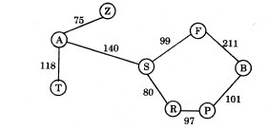
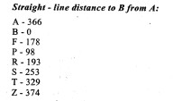
A* Exercise
How will A* get from A to B?

Slide 22
Admissible Heuristics
A heuristic h(n) is admissible if for every node n,
h(n) ≤ h*(n), where h*(n) is the true cost to reach the goal state from n.
An admissible heuristic never overestimates the cost to reach the goal, i.e., it is optimistic
Example: h_{SLD}(n) (never overestimates the actual road distance)
Theorem: If h(n) is admissible,
A* using TREE-SEARCH is optimal

Slide 23

Admissible Heuristics
Admissible Heuristics for the 8-puzzle:
h₁(n) = number of misplaced tiles
h₁(S) = 8
h₂(n) = total Manhattan distance
(sum the walking distance from each square
to its desired location)
h₂(S) = 3+1+2+2+2+3+3+2 = 18

Slide 24

Consistent Heuristics
A heuristic is consistent if for every node n,
every successor n' of n generated by any action
h(n) ≤ c(n,a,n') + h(n')
If h is consistent, we have
f(n') = g(n') + h(n')
= g(n) + c(n,a,n') + h(n')
≥ g(n) + h(n)
= f(n)
i.e., f(n) is non-decreasing along any path.
Theorem: If h(n) is consistent, A* using GRAPH-SEARCH is optimal
consistency is also called monotonicity

Slide 25
Dominance
If h₂(n) ≥ h₁(n) for all n (both admissible),
then h₂ dominates h₁
→ h₂ is better for search
Typical search costs (average number of nodes expanded)
for 8-puzzle:
d=12 IDS = 3,644,035 nodes
A*(h₁) = 227 nodes
A*(h₂) = 73 nodes
d=24 IDS = too many nodes
A*(h₁) = 39,135 nodes
A*(h₂) = 1,641 nodes

Slide 26
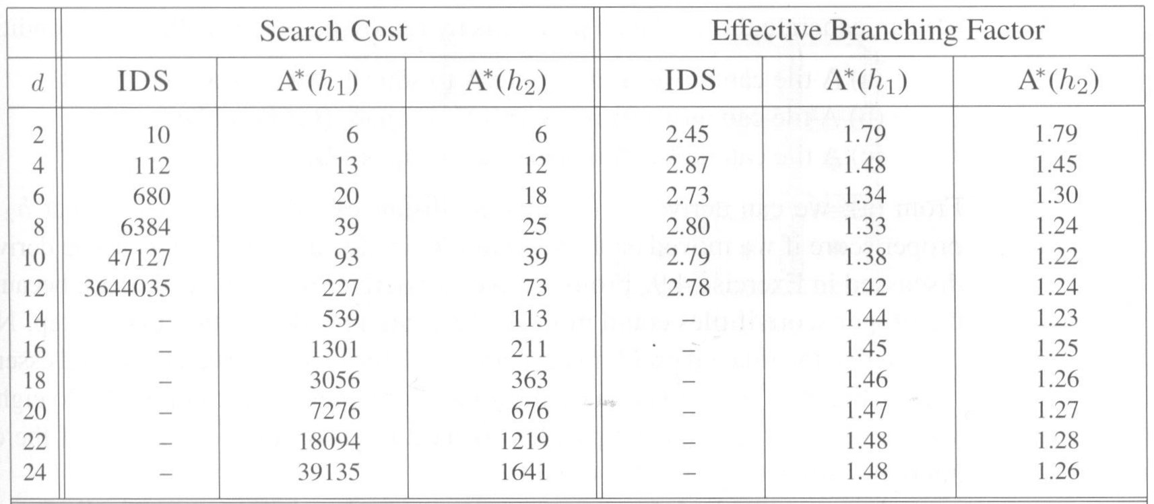
Comparing 8-puzzle Heuristics
h₂ dominates h₁ → h₂ is better heuristic

